Slide 1


The eXtensible Application Framework
by Shahid N. Shah

Slide 2

Sparx Components
Sparx is a family of products.
Sparx XAF (eXtensible Application Framework) is the Java class library. “Sparx” and “XAF” will be used synonymously.
Sparx ACE (Application Components Explorer) is an online application documentation and exploration tool. ACE may be considered the XAF UI, but should not be confused with an IDE (integrated development environment).

Slide 3
Sparx Benefits
Application Programmers spend time on real features significant to end-users instead of infrastructure issues significant only to programmers.
Most of the user interface and database logic is coded in a declarative style using XML instead of programmatic style using Java.
Applications are built by combining declared UI (forms/dialogs) and database (SQL) components combined with application-specific business logic.

Slide 4
Sparx Positioning
Sparx Applications (ACE, User-specific)
DB
SQL
UI
Config
Control
Report
Security
Values
Sparx API
JSPs
JDBC
Servlets
JNDI
JAXP
Server-side Java (J2EE)
3rd
Party
Swing
AWT
Java (JDK, JVM, JRE)
Operating System (Java Capable – e.g. Win32, UNIX)

Slide 5
ACE Features
ACE is itself a XAF application that basically helps to explore and document application components.
Creates automatic implementation documentation for all declarative components like forms, rules, SQL, and dynamic queries.
Allows interactive testing of forms, validation, SQL statements, database connectivity, and dynamic queries.
Serves as a centralized project documentation manager.

Slide 6
Key XAF Features
Supports low or no-html code preparation (move to XML-based declarative programming for most common needs)
Provides automated navigation (and automatically register new applications) for applications that don’t need advanced user interfaces or custom navigation
Automates forms/input management (using dialogs that can be pooled/reused, automatically validate complex data requirements, and are skinnable)
Automates reports/output preparation (using pooled SQL statements and skins)
Automates common query requirements by allowing moderately-complex SQL select statements to be generated automatically by end-users, executed in the database, and returned as paged XAF reports
Allows Schemas to be specified in XML and generate appropriate SQL DDL
Implements common design patterns like MVC and Factories

Slide 7
Prerequisites
Basic knowledge of web-based applications and how they differ from traditional apps
Basic knowledge of Java2, JVMs, the Servlet API, and Java Server Pages (JSPs)
Java2 JDK (1.3.x)
Application Server (Tomcat, Resin, etc) supporting Servlet 2.2 and JDBC 2.0 APIs
Jakarta Ant 1.3
Jakarta Log4J 1.1
Jakarta ORO 2.0
Apache Xerces 1.4
Apache Xalan 2.1

Slide 8
XAF Modules
Value Sources for dynamic access to variables from XML
Centralized Configuration
Advanced Forms/Dialog Management
Log Management
MVC Page Control and automated navigation
HTML Management
Database Connectivity
Consistent user interfaces based on “skins”
SQL Statements Management, Pooling, and tracking
SQL Query Definitions for dynamic SQL
Integrated report writer
Fine-grained security and access control

Slide 9
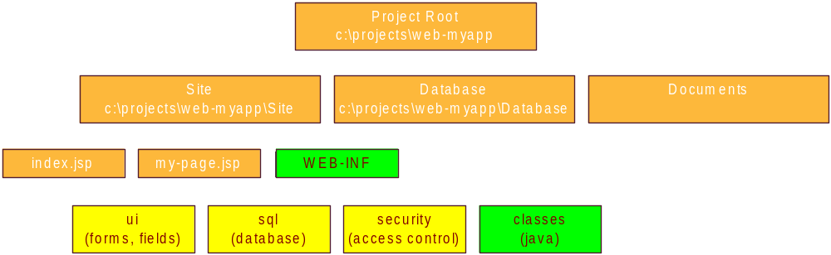

XML Sources
All declarative structures are created in XML files.
Sparx XML files have a root tag of <xaf>.
Every XML file is considered an XML Source and can contain <include> directives to include other, perhaps centralized XML files.

Slide 10
Value Sources
A Value Source is the source of a single value, or a collection of values (a data object), for use in many places throughout Sparx. The format of a value source is similar to a URL (name:params).
  request:abc
  session-attr:abc
  form:abc
A SingleValueSource is an object that returns a single value from a particular source (like a request parameter, text field, or session attribute).
A ListValueSource is an object that returns a list of values from a particular source (like a select field or SQL query).

Slide 11
Centralized Configuration
All Sparx applications use a single XML-based repository for all configuration items.
Sparx configuration files contain <property> and <properties> tags that can use dynamic value replacements to define properties that depend on the runtime values of other properties.
Unlike Java properties, Sparx configuration files allow programmers to define dynamic properties driven by value sources that change their values depending upon the execution environment (request-time parameters, session attributes, etc).

Slide 12
Advanced Dialogs
XAF
Forms
Specify Controls
Requirements
(XML tags)
String
Number
Date
Date Range
List
Checkbox
Radio Buttons
Multi-select list
Custom lookups
Query lookups
Generate Form HTML
Validate Form

Slide 13
Dialog Features
Dialogs specified as XML tags with zero HTML knowledge (including labels, validation, conditions, etc).
Data Persistence allows easy handling of stateless HTML pages by automatically filling in controls with appropriate values without programmer involvement.
Server-side data binding to HTML controls allows queries to be executed and automatically bound to controls such as list boxes.

Slide 14
More Dialog Features
Completely automatic advanced validation features.
Skins provide consistency look and feel and allows the same code to run on a variety of browsers and platforms (e.g. hand-helds).
Form Objects provide caching of dialog definitions for high performance.
Transaction integrity through unique per-request dialog identifiers

Slide 15
Data Management
SQL Statement Pooling – create and store all static SQL statements with bind parameters in a single repository
Data Aggregation – aggregate data from multiple sources
SQL DML Generation – automatically generate insert/update/delete statements
SQL Select Generation – allows end-users to automatically generate select statements from a set of programmer-defined rules and user interface

Slide 16
Schema Objects
XML-based schema creation and database-independent repository
Object-based relational tables
DDL generation
Schema and meta data available within applications and closely tied to ui

Slide 17
Report Writing
XML-based report definitions that are tied to actual SQL statements.
Multiple source reports.
Skins for multiple output styles and destinations (user can select paged, single-page, CSV, etc).
Developers worry mainly about specifying what data to output instead of how to output the data.

Slide 18
Security
Built-in fine-grained security through the use of hierarchical access control lists (ACLs).
Personalization features allow specific components to be shown based on user names, locations, etc.

Slide 19
Conclusion

